Slide 1
MediAssist AI - Healthcare Guidance Platform
Team 3:
Aparna Bharathi Suresh
Pavan Srivatsav Devarakonda
Sai Naga Sanjana Chippada
Shravani Dattaram Gawade
Sujatha Deepraj Joshi

Slide 2
Introduction

Slide 3
Built an AI Healthcare Assistant that answers non-emergency medical questions and explains prescriptions.
Addresses patient questions on medical terms, dosages, and chronic care guidance.
Reduces burden on clinicians by providing safe, accessible, on-demand support.
Fine-tuned multiple medical LLMs and selected the best model for deployment on Google Cloud.
Objective: Deliver clear, reliable, and privacy-preserving medical guidance to improve patient understanding and care.

Slide 4
Data Engineering

Slide 5
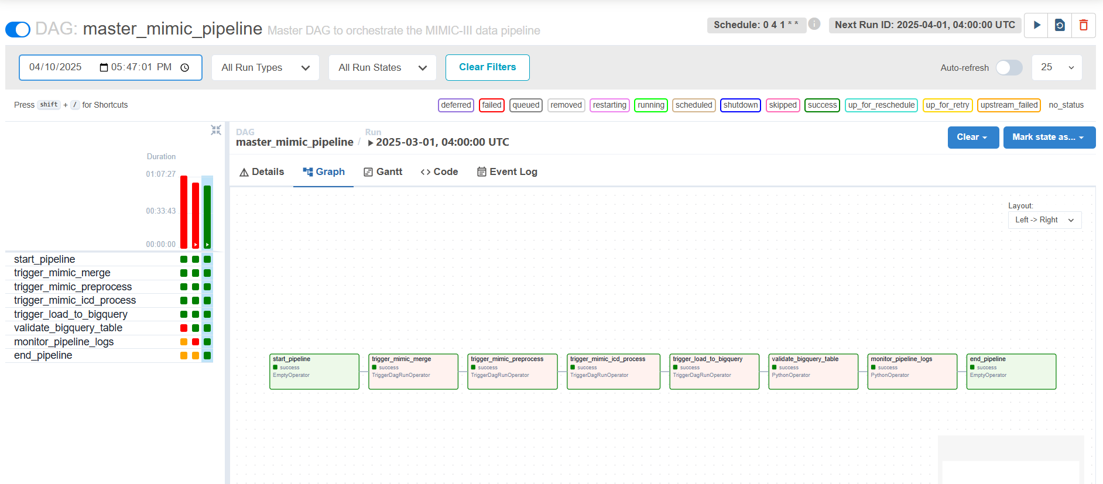
Created ETL pipeline to extract MIMIC III, MIMIC IV, iCliniq, MedQuAD datasets and transformed them into a single Q&A dataset and stored in the GCP bucket.

Slide 6
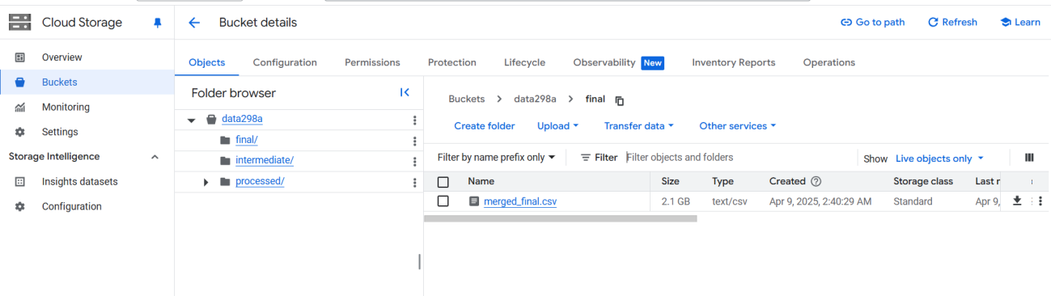

Slide 7
Models

Slide 8
Selected Models:
MedLlama3: General-purpose Q&A and patient education
BioMistral-7B: Biomedical knowledge retrieval and clinical research
MedAlpaca: Lightweight generative medical text and Q&A model,
Meditron: Advanced medical reasoning and differential diagnosis

Slide 9
Evaluation Results

Slide 10
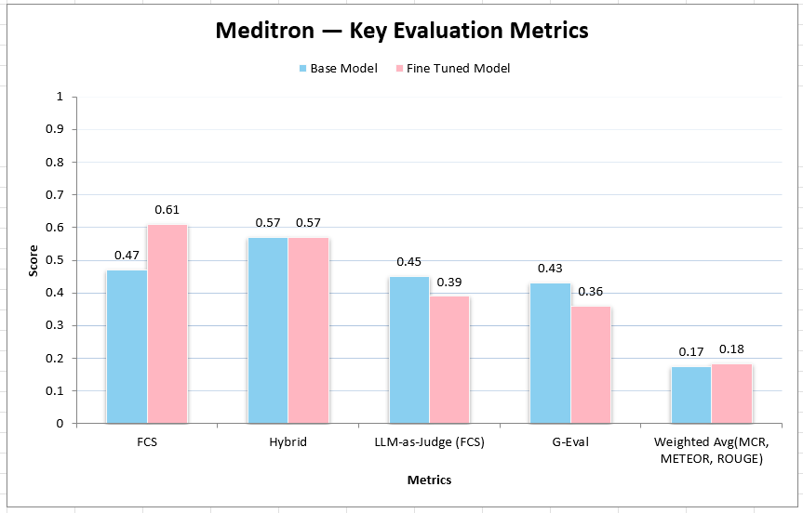

Slide 11
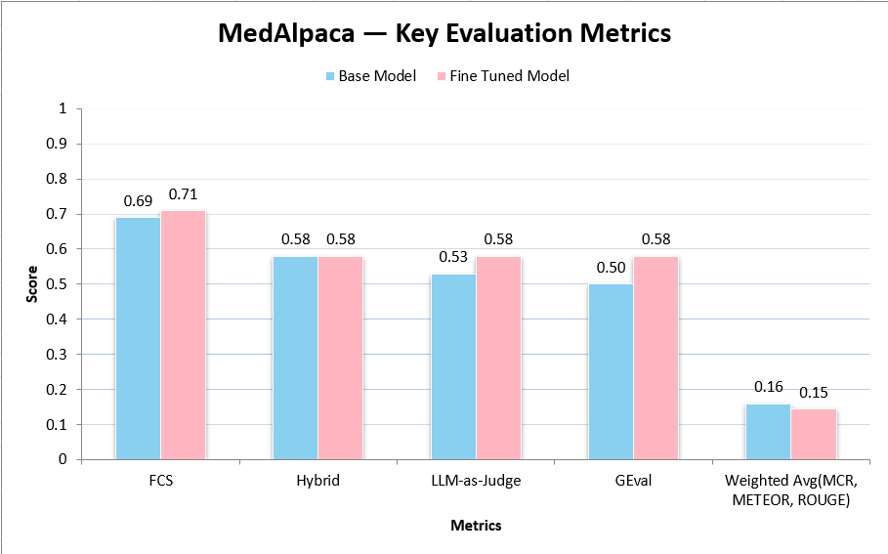

Slide 12
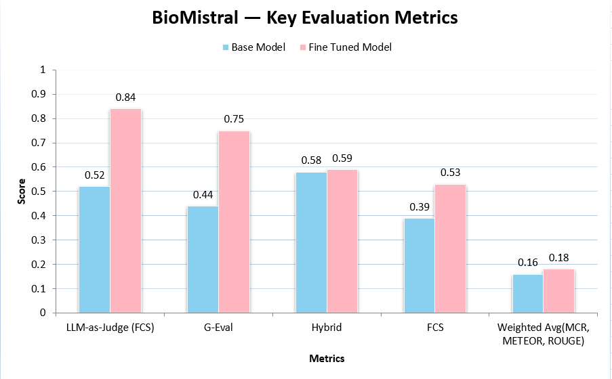

Slide 13
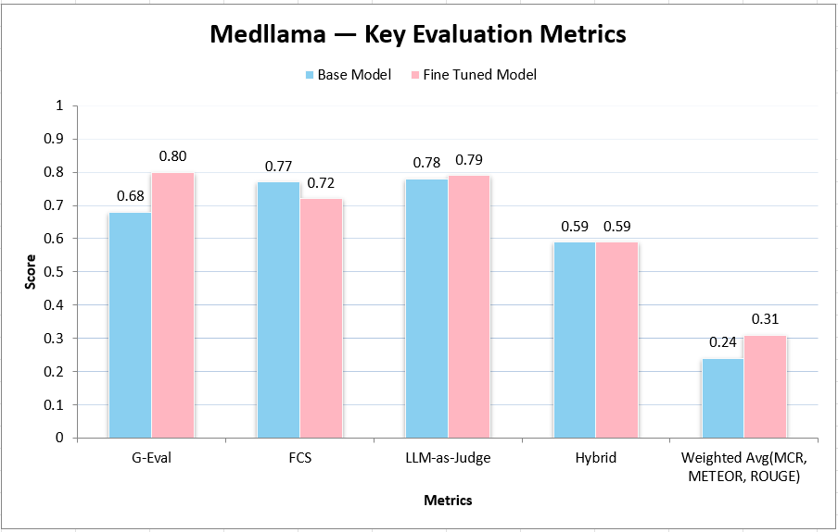

Slide 14
RAG Evaluation
Metric | Fine-Tuned Model
Retriever Metrics
Avg Contextual Precision | 0.652
Avg Contextual Recall | 0.5227
Avg Contextual Relevancy | 0.4478
Generator Metrics
Faithfulness | 0.5593
Answer Relevancy | 0.7649

Slide 15
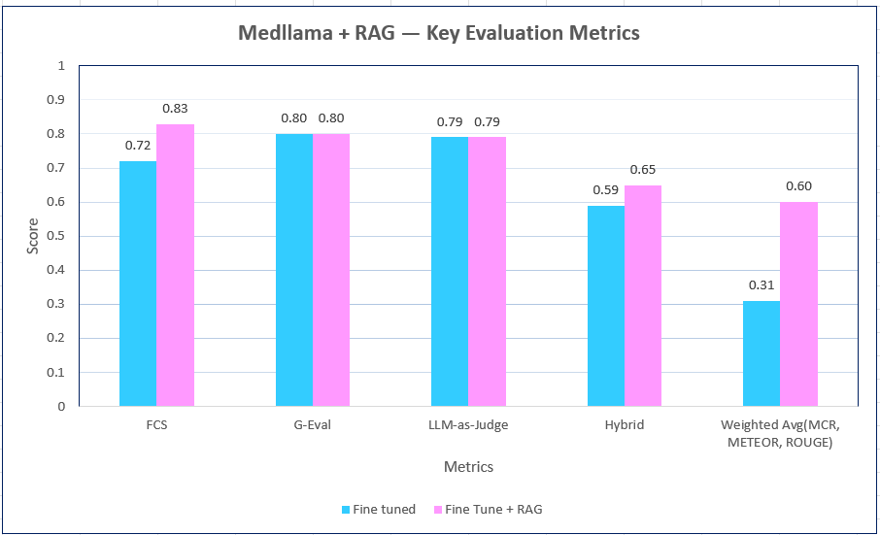

Slide 16
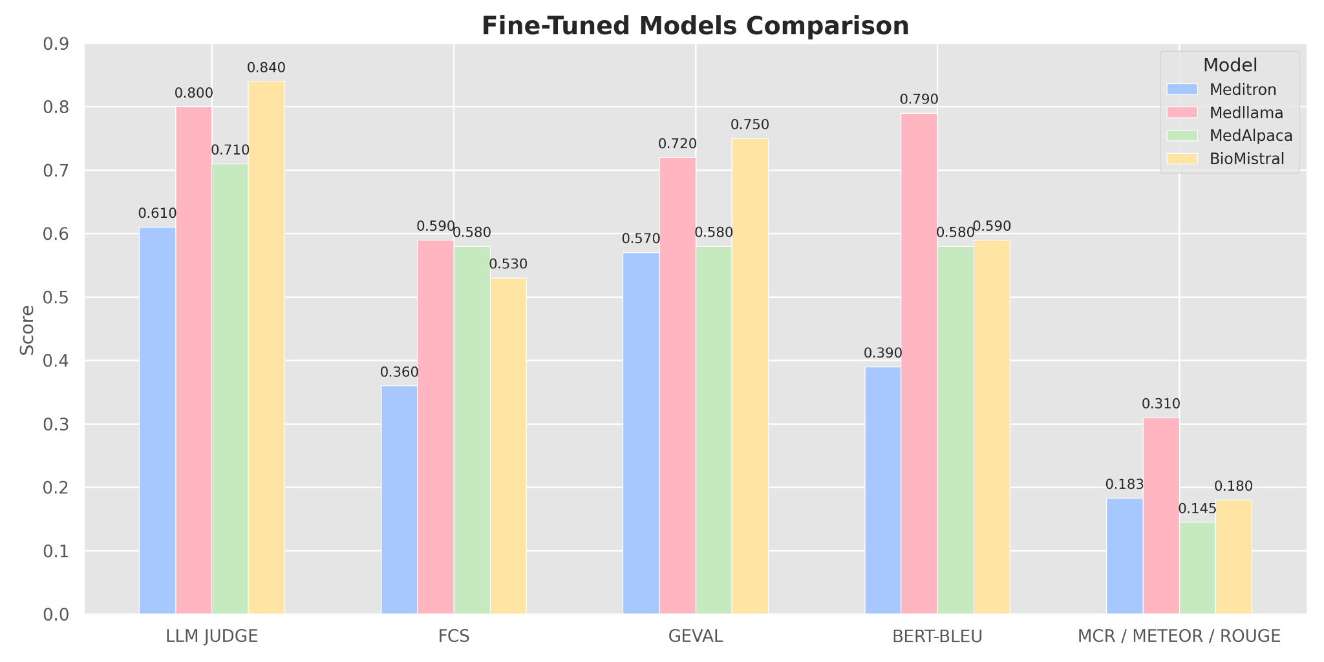

Slide 17
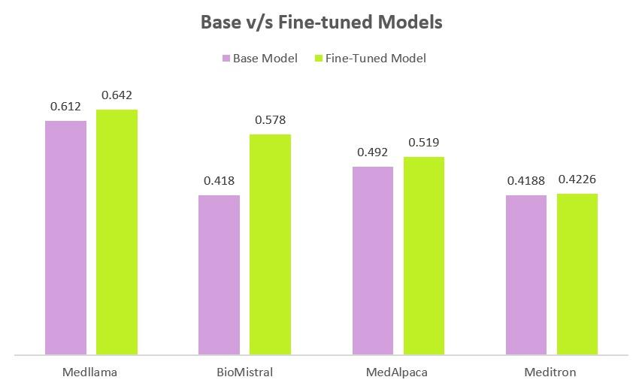
Weighted Avg of all the mertices

Slide 18
System Development

Slide 19
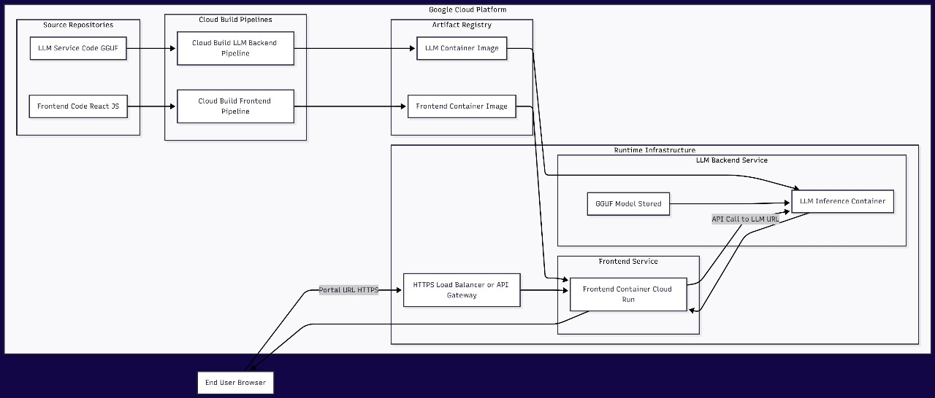

Slide 20
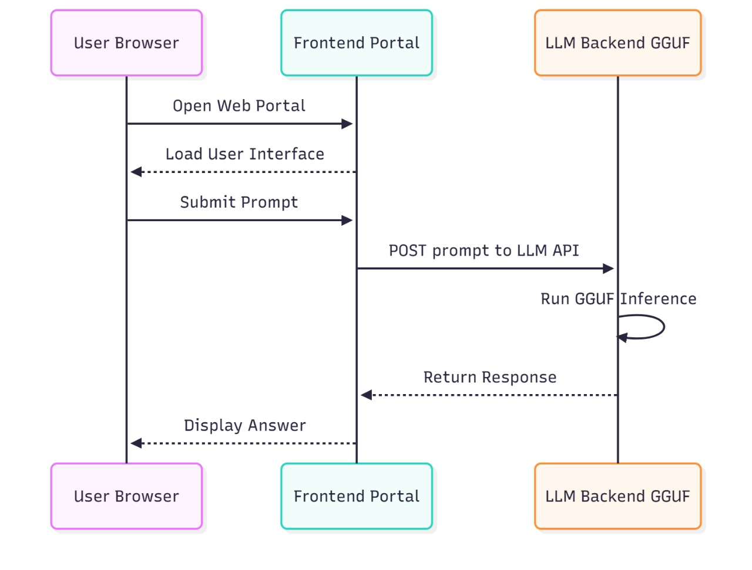

Slide 21
Demo

Slide 22
Thank You

